Slide 1
Open Source Software Foundations
why you should care about
Jon Galloway | @jongalloway | jon@dotnetfoundation.org

Slide 2

*record scratch*
*freeze frame*
Photo by Luana De Marco on Unsplash

Slide 3

I have questions
.NET is open source?
Why does it have a
Foundation?
Photo by Camylla Battani on Unsplash

Slide 4
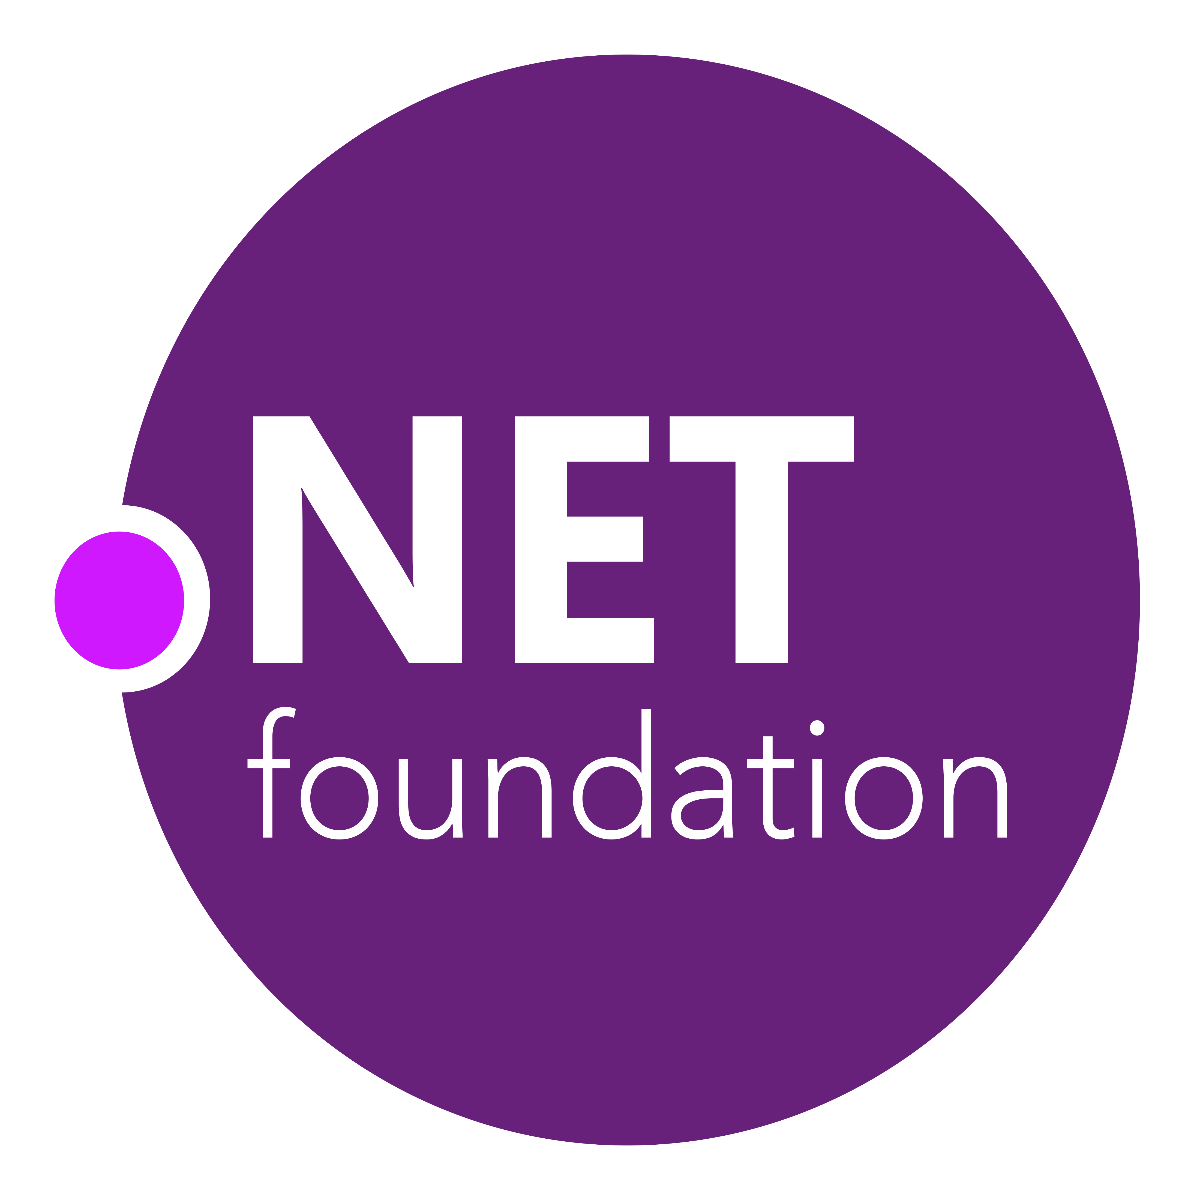

.NET Open Source Journey
.NET
Aug. 2017
.NET Core 2.0 released
2001
ECMA 335
2008
ASP.NET MVC (web platform) open source
April 2014
.NET Compiler Platform (“Roslyn”) open source
.NET Foundation founded
Fall 2019
.NET Core 3.0
2016
Mono project joins .NET Foundation
2002
NET 1.0 for Windows released. Mono project begins
Dec. 2018
.NET Core 2.2 released
.NET Core 3.0 preview
WinForms and WPF go open source
Nov. 2014
.NET Core (cross-platform) project begins

Slide 5

87%
contributors outside Microsoft
.NET open source
momentum
61,000+
accepted PRs from community

Slide 6
.NET Growth Continues
>1 million .NET Core developers
Visual Studio, Visual Studio for Mac, Visual Studio Code
Visual Studio
+1 million new monthly active .NET developers in last year

Slide 7
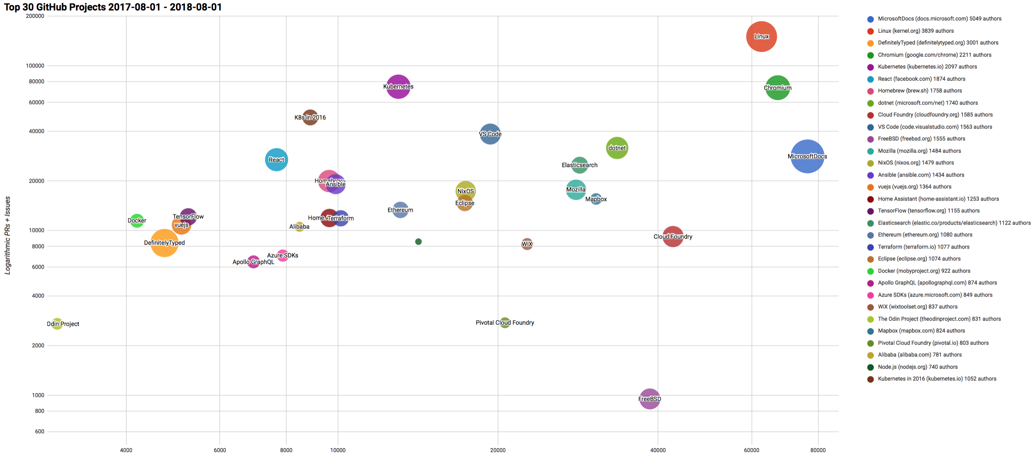

Top 30 Highest Velocity OSS Projects on GitHub
https://www.cncf.io/blog/2017/06/05/30-highest-velocity-open-source-projects/
https://raw.githubusercontent.com/cncf/velocity/master/charts/top30_20170801_20180801.png

Slide 8
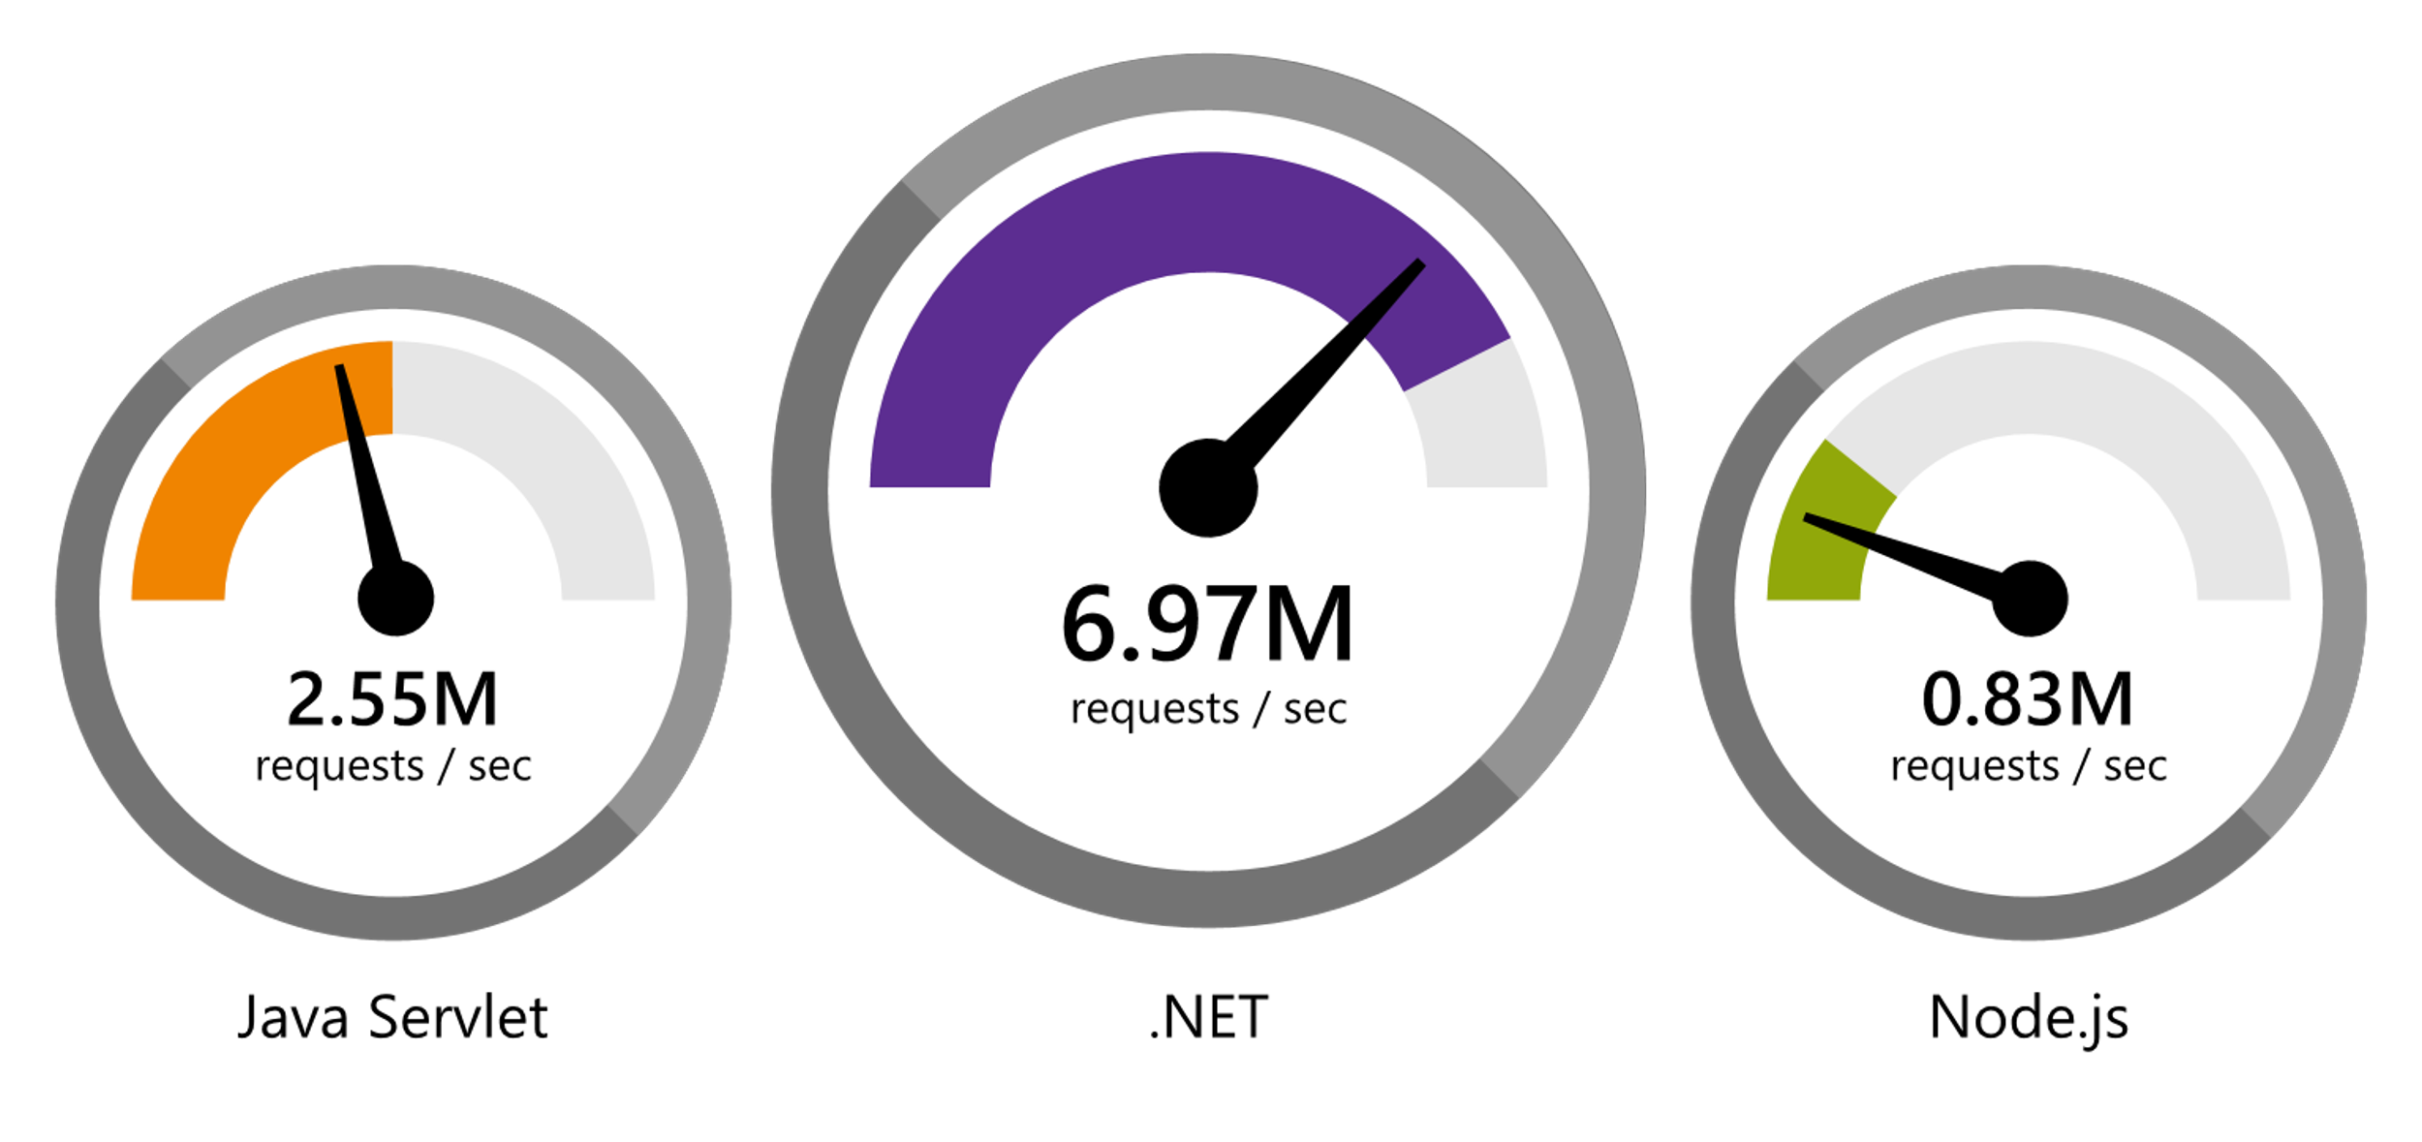
.NET
Faster than any other popular framework
Data sourced from official tests available at TechEmpower Round 16.
“Using the same-size server, we were able to go from 1,000 requests per second per node with Node.js to 20,000 requests per second with .NET Core.“ — Raygun
www.dot.net/customers
Notes:
We’ve made significant investments in the platform especially in terms of performance.
The popular TechEmpower benchmark compares web application frameworks with tasks like JSON serialization, database access, and server side template rendering - .NET performs faster than any other popular framework.
https://www.techempower.com/benchmarks/#section=data-r16&hw=ph&test=plaintext
In the latest benchmarks on raw platform performance, .NET is more than 8 times faster than Node.js

Slide 9
Why does it have a Foundation?
Photo by Camylla Battani on Unsplash

Slide 10
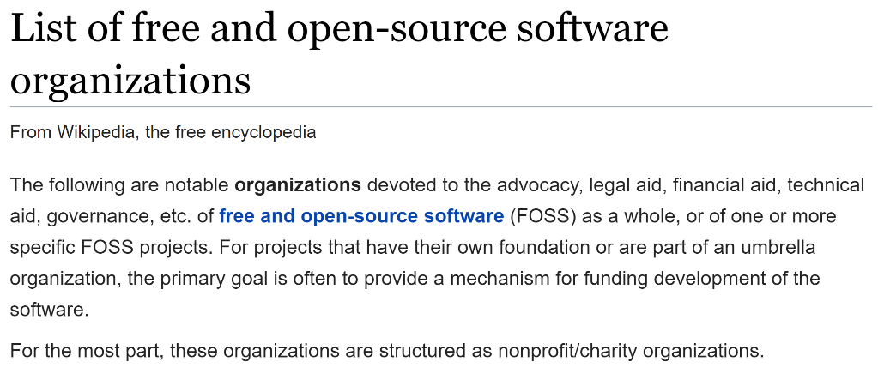


Let’s ask Prof. Wikipedia
https://en.wikipedia.org/wiki/List_of_free_and_open-source_software_organizations
https://en.wikipedia.org/wiki/List_of_free_and_open-source_software_organizations

Slide 11
What Problems Do Open Source Software Foundations Solve?

Slide 12
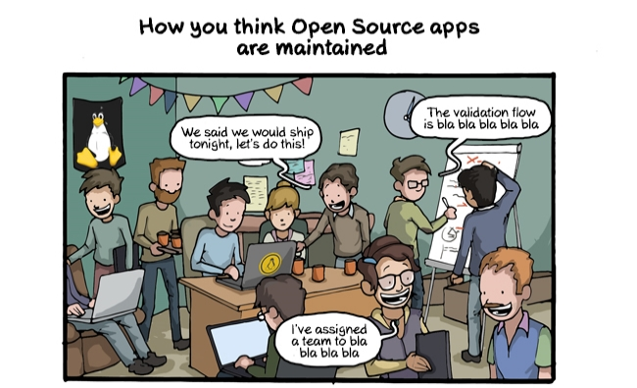

http://www.commitstrip.com/en/2014/05/07/the-truth-behind-open-source-apps/ - used with permission

Slide 13
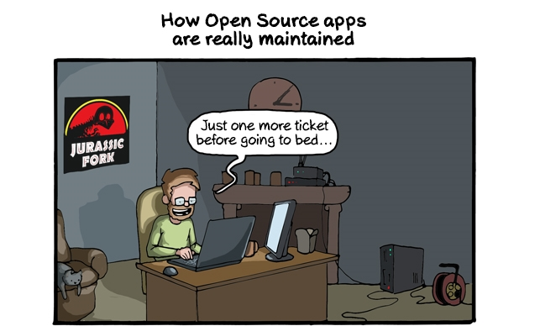
http://www.commitstrip.com/en/2014/05/07/the-truth-behind-open-source-apps/ - used with permission

Slide 14
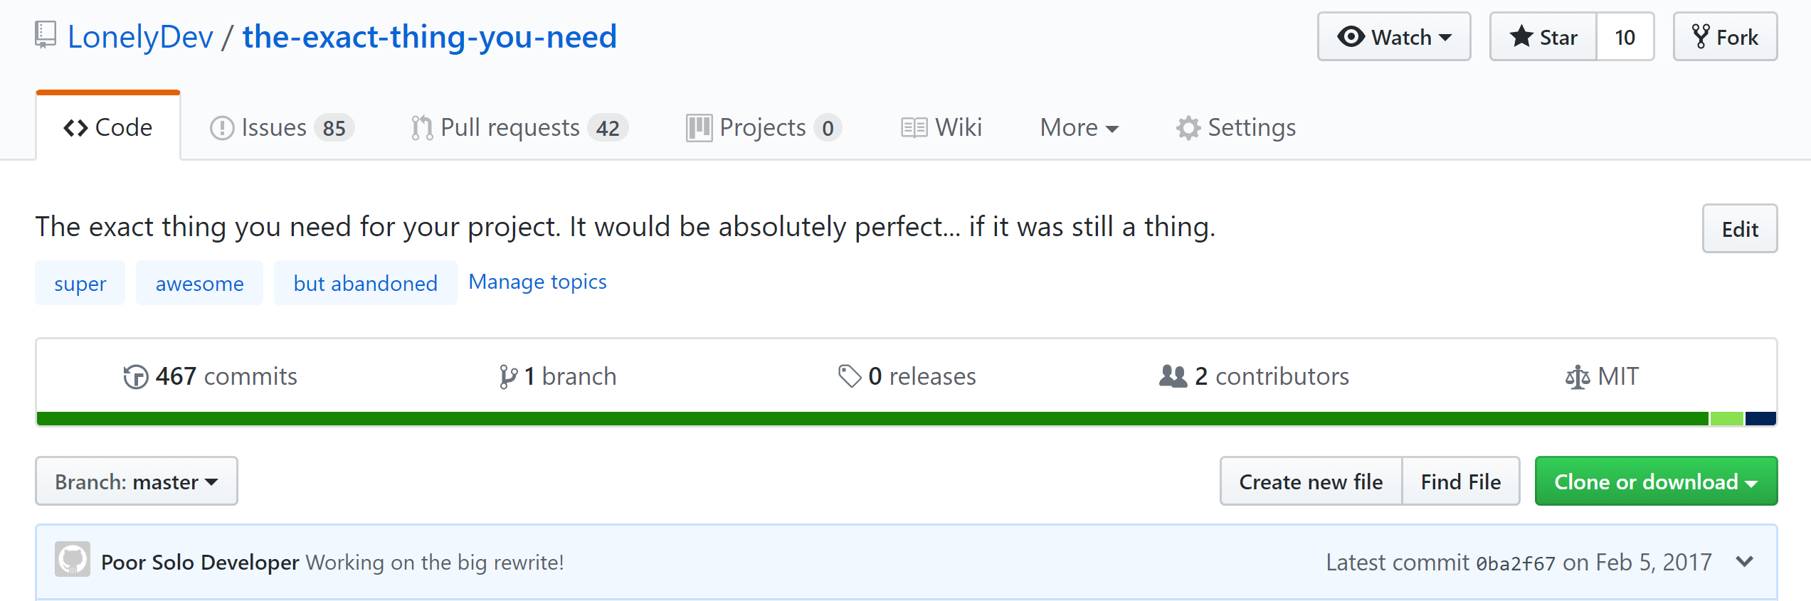

Slide 15
Open Source Sustainability

Slide 16
Make Sure
You Can Depend On Open Source Projects
You Care About

Slide 17
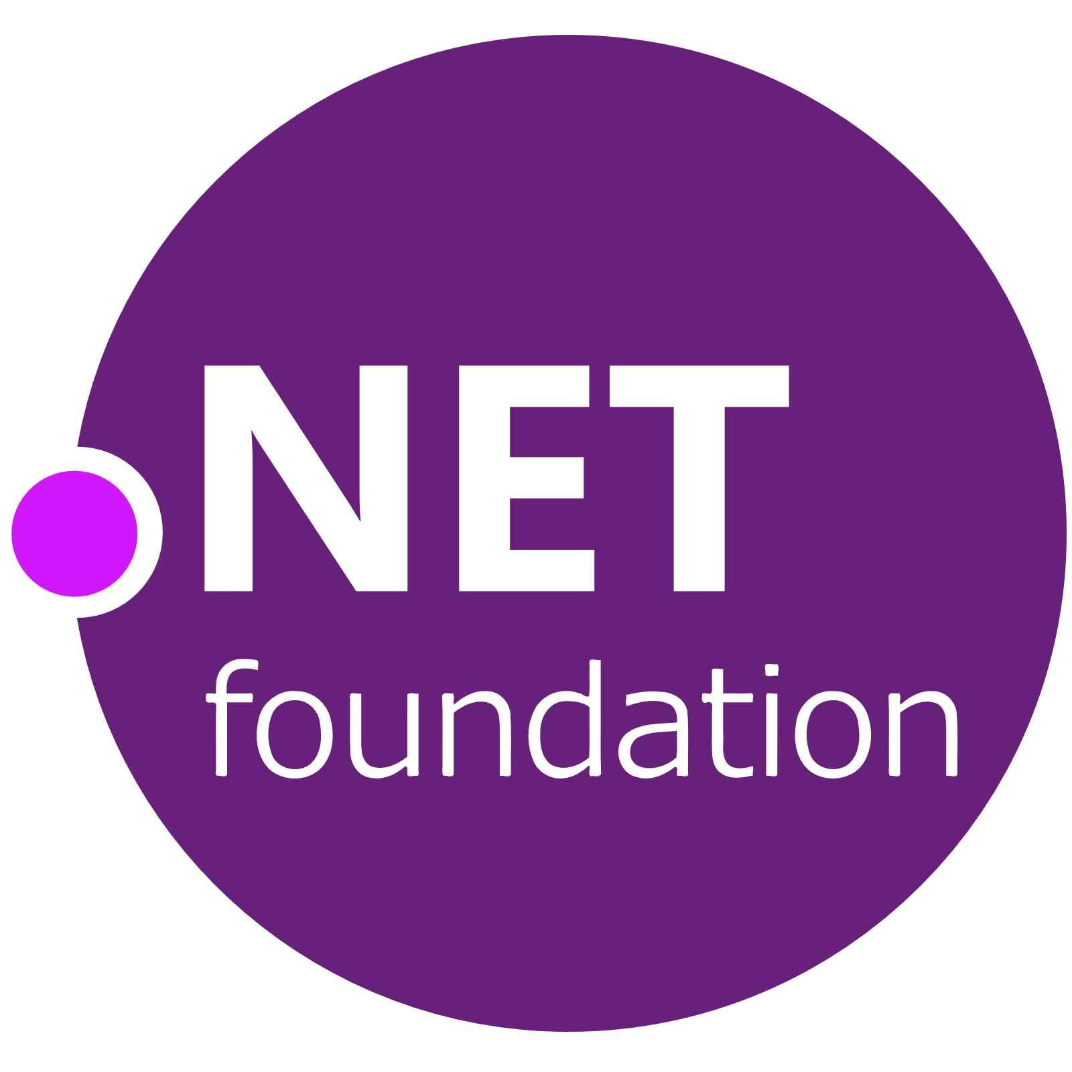
[Case Study]

Slide 18
Collaboration

Slide 19

Before:
.NET was a part of Microsoft
Microsoft
.NET

Slide 20






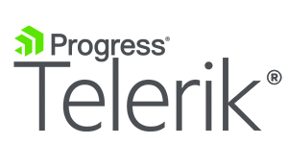

After:
Microsoft is a part of the .NET Foundation

Slide 21
Project Support

Slide 22

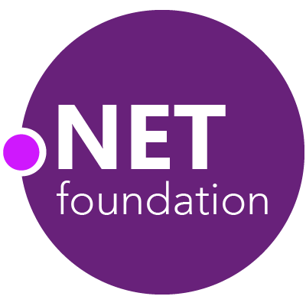
Steeltoe
.NET Core
Microsoft Web Protection Library
MSBuild
DotNetNuke
ASP.NET AJAX Control Toolkit
ASP.NET Core
SourceLink
Microsoft Azure WebJobs SDK
Salesforce Toolkits for .NET
nUnit
MVVM Light Toolkit
IronPython
Mailkit
WorldWide Telescope
Nancy
Open XML SDK
.NET SDK for Hadoop
MvvmCross
MEF
JSON.NET
Mimekit
xUnit
ASP.NET Web Pages
NuGet
IdentityManager
Couchbase Lite for .NET
ML.NET
iOS
macOS
MiniProfiler
Entity Framework
.NET ECOSYSTEM
WCF
ILMerge
Xamarin.Mobile
ASP.NET SignalR
Infer.NET
.NET Micro Framework
StackExchange.Redis
Mono
protobuf-net
Open Live Writer
Xamarin.Auth
Xamarin SDK
Orchard CMS
OWIN Authentication Middleware
ProtoBuild
IdentityServer
Microsoft Azure SDK for .NET
.NET Compiler Platform ("Roslyn")
Prism
ASP.NET Web API
Cake
Orleans
Kudu
Cecil
LLILC
Umbraco
System.Drawing
ASP.NET MVC
Notes:
The .NET Foundation is our center of gravity for open development and collaboration around the .NET ecosystem. The .NET Foundation has over 50 projects and hundreds of repos under its stewardship. Open Source Software foundations provide protection, support, services and best practices for helping each project be successful and to grow the ecosystem of people and software.

Slide 23
IP / Legal Support
Review as projects join
Legal services
CLA
d/b/a registration

Slide 24
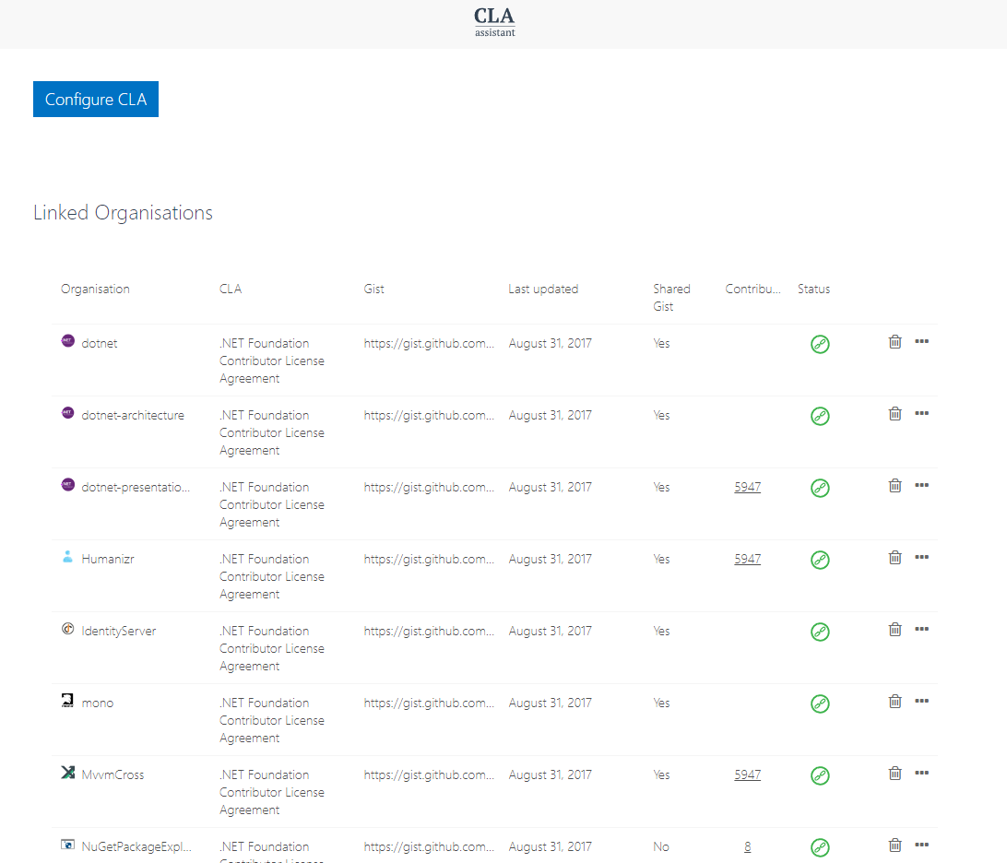
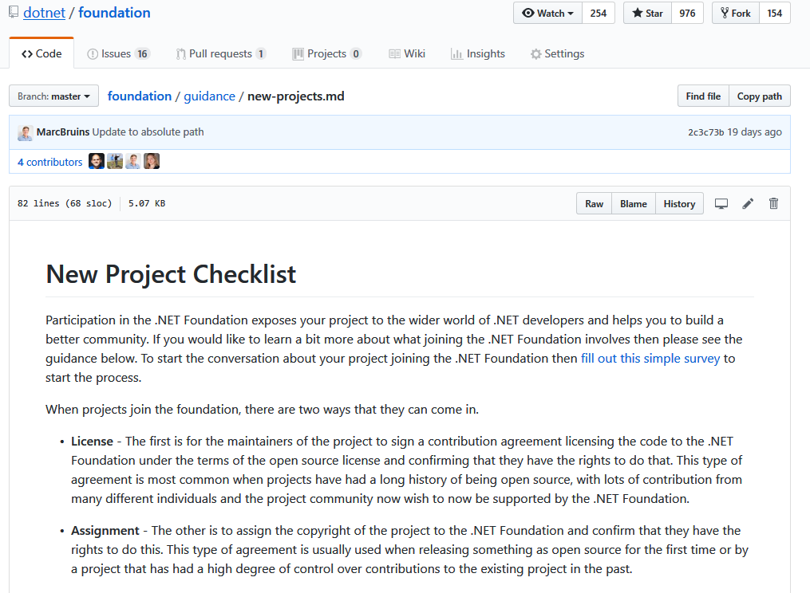

Slide 25
Certificates
HTTPS
Code Signing (via d/b/a)

Slide 26
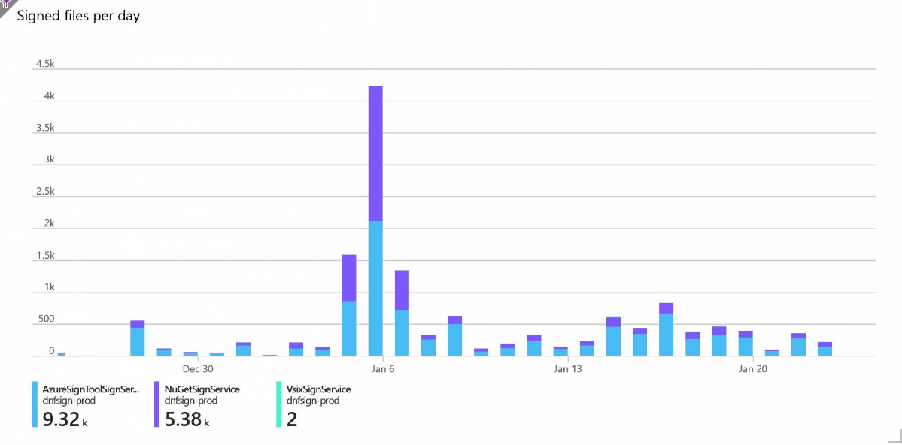

Slide 27
DevOps
CI / CD
Package Feeds

Slide 28
Hosting
Web Hosting
Service Hosting
DNS

Slide 29
SAAS
Office 365
Slack
LastPass

Slide 30
Marketing and Communications
Monthly Newsletter: 650 subscribers + blog
Project Leader Newsletter
Meetup Leader Newsletter
Website + Blog + Social
YouTube

Slide 31
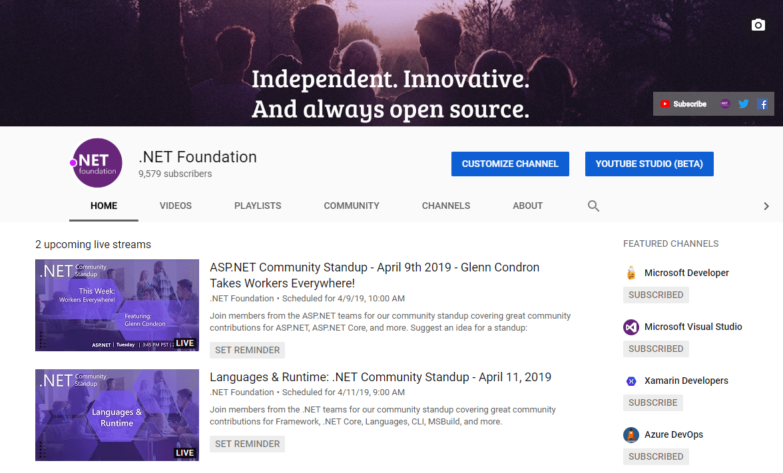
Marketing and Communications

Slide 32
Community

Slide 33
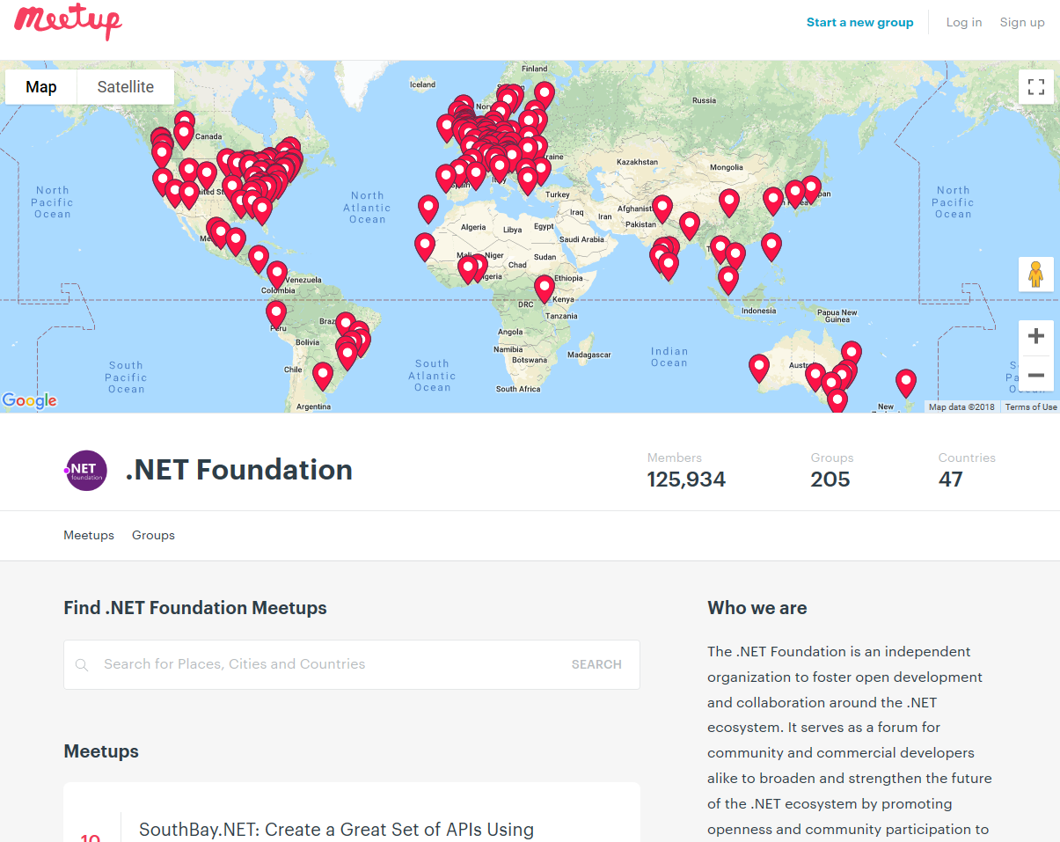
Groups
290
Members
208,000
Countries
59
Join us: meetup.com/pro/dotnet

Slide 34
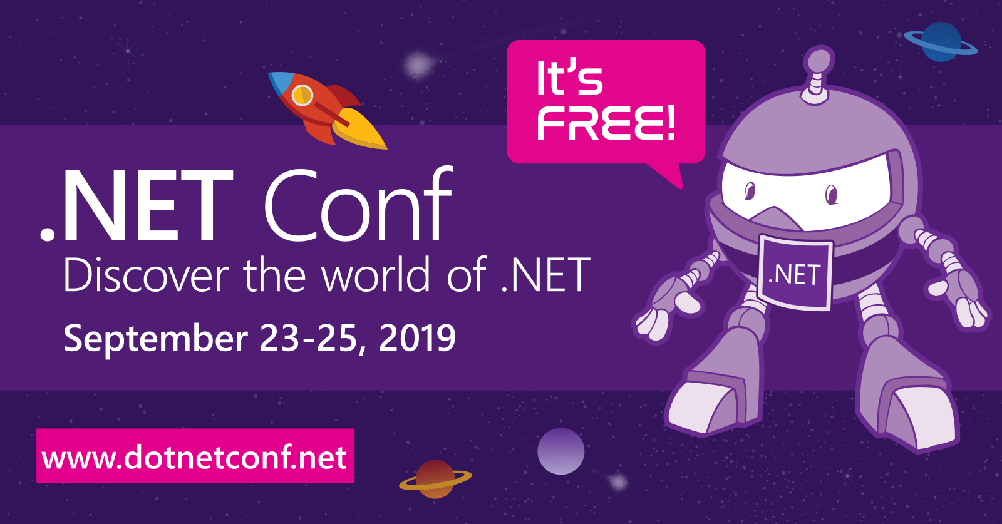
Announcing .NET Conf 2019
Save the date!
Beth TODO

Slide 35
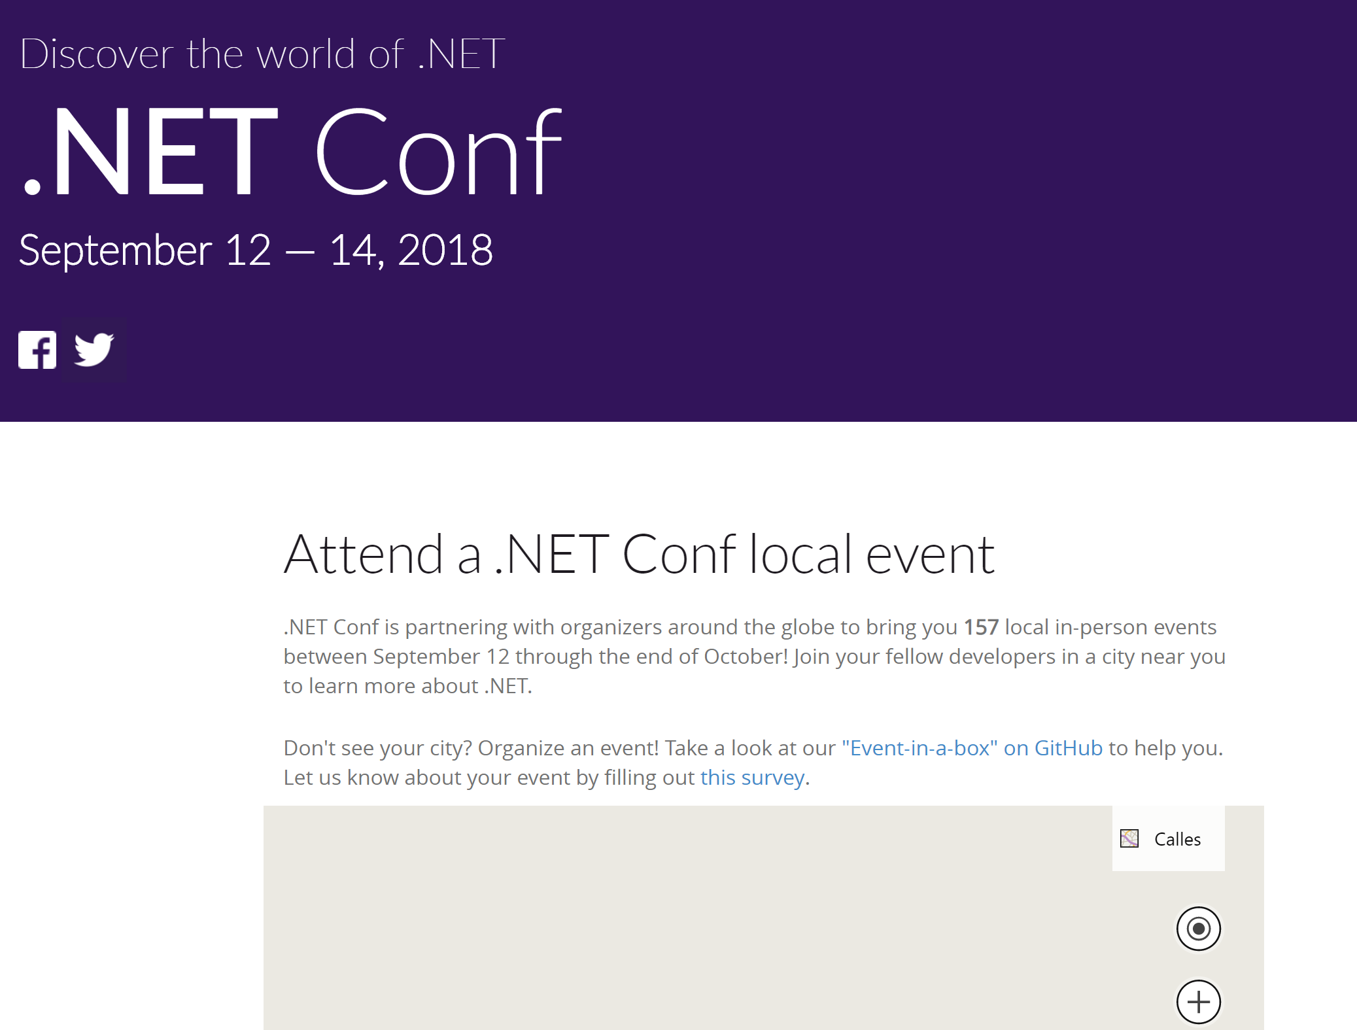
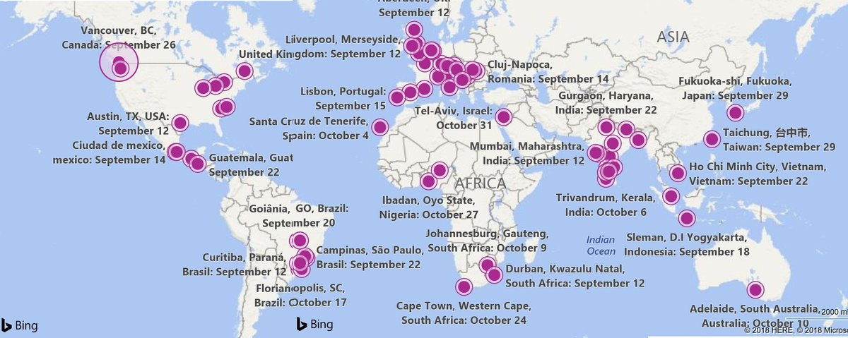

Slide 36
What We’ve Been Doing
Member Projects
Project Services
Meetups
Marketing and Communications
Strategic Stuff
Events

Slide 37
What’s New
Corporate Sponsorship
Open Membership
Open Elections

Slide 38

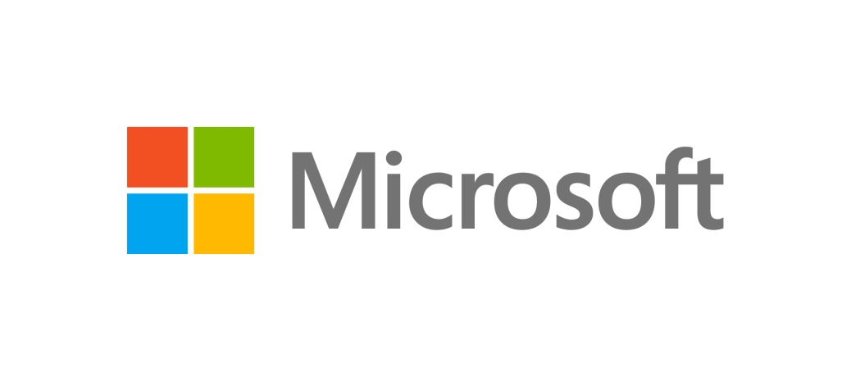
Technical Steering Group + Corporate Sponsors

Slide 39
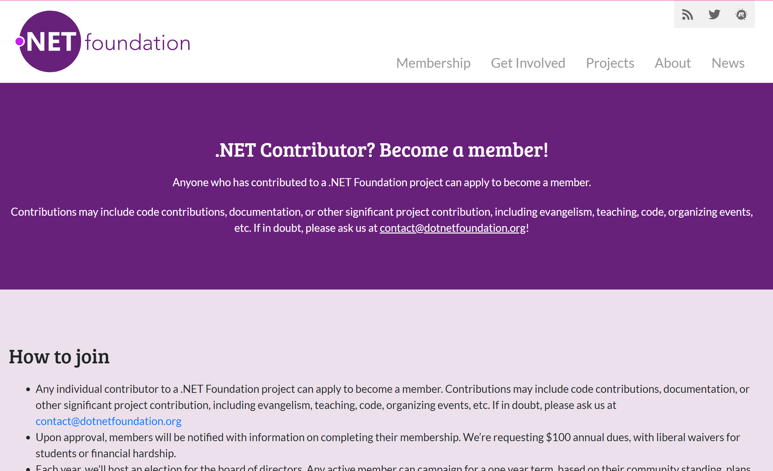

Slide 40
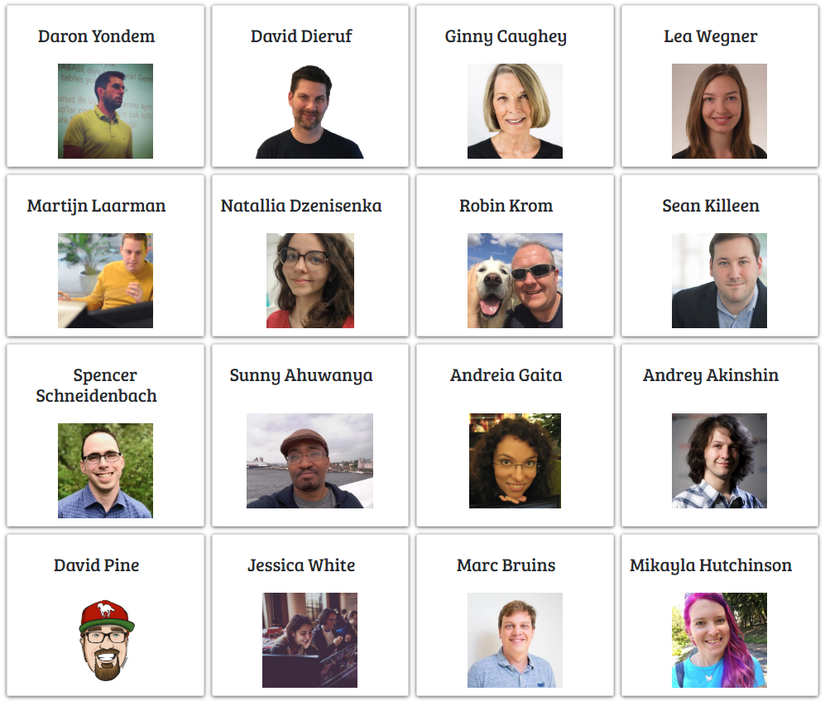
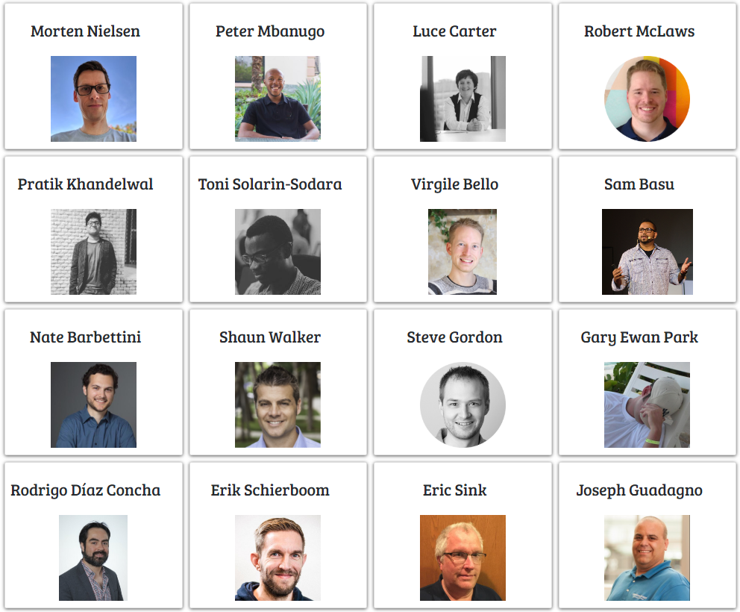
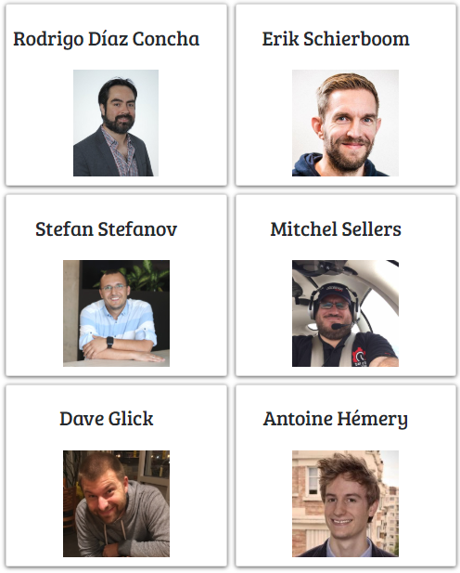
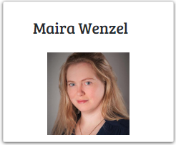

Membership & Elections
430 Members (out of 700 applications)
45 Election Candidates

Slide 41
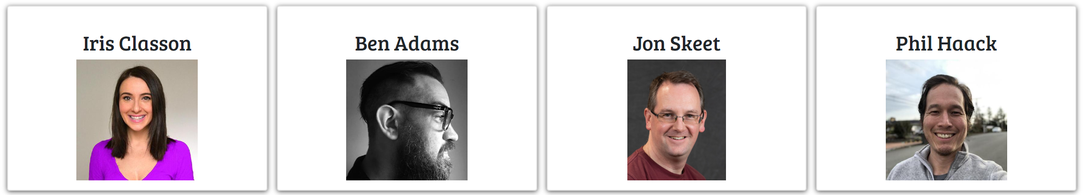
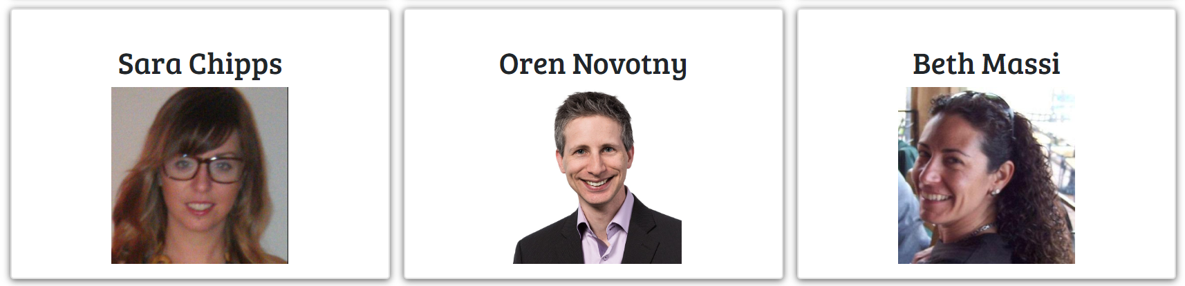
Membership & Elections

Slide 42
Action Groups
Outreach
Project Support
Membership
Marketing and Communication
Corporate Partnership
Technical Oversight
Speaker Bureau and Meetups

Slide 43
Some other stuff we’re thinking about
Fiscal support (sponsorship, financial services)
Connecting: Companies + Projects + Community
Speaker Bureau
d/b/a -> LLC
Project maturity levels

Slide 44
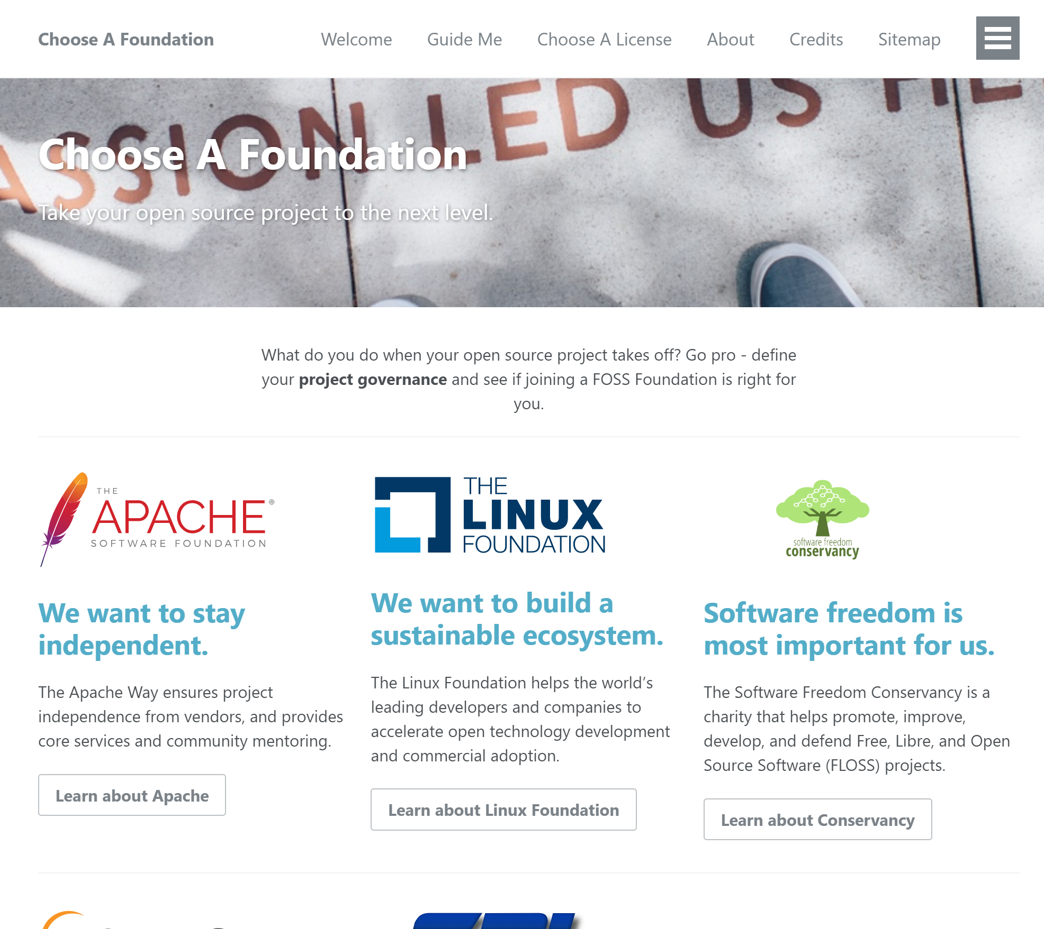
Some other Open Source Software Foundations

Slide 45
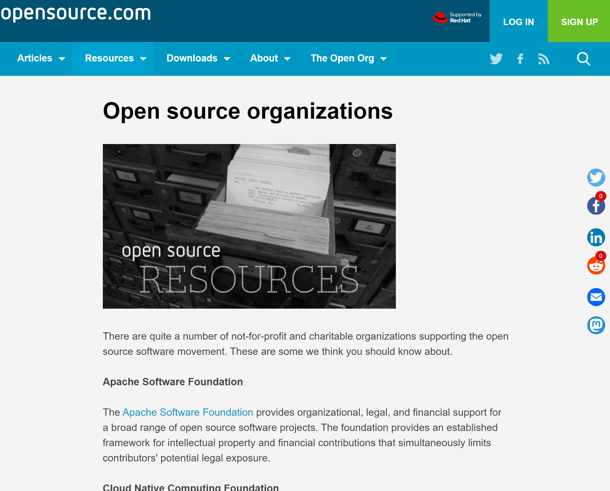
Some other Open Source Software Foundations

Slide 46
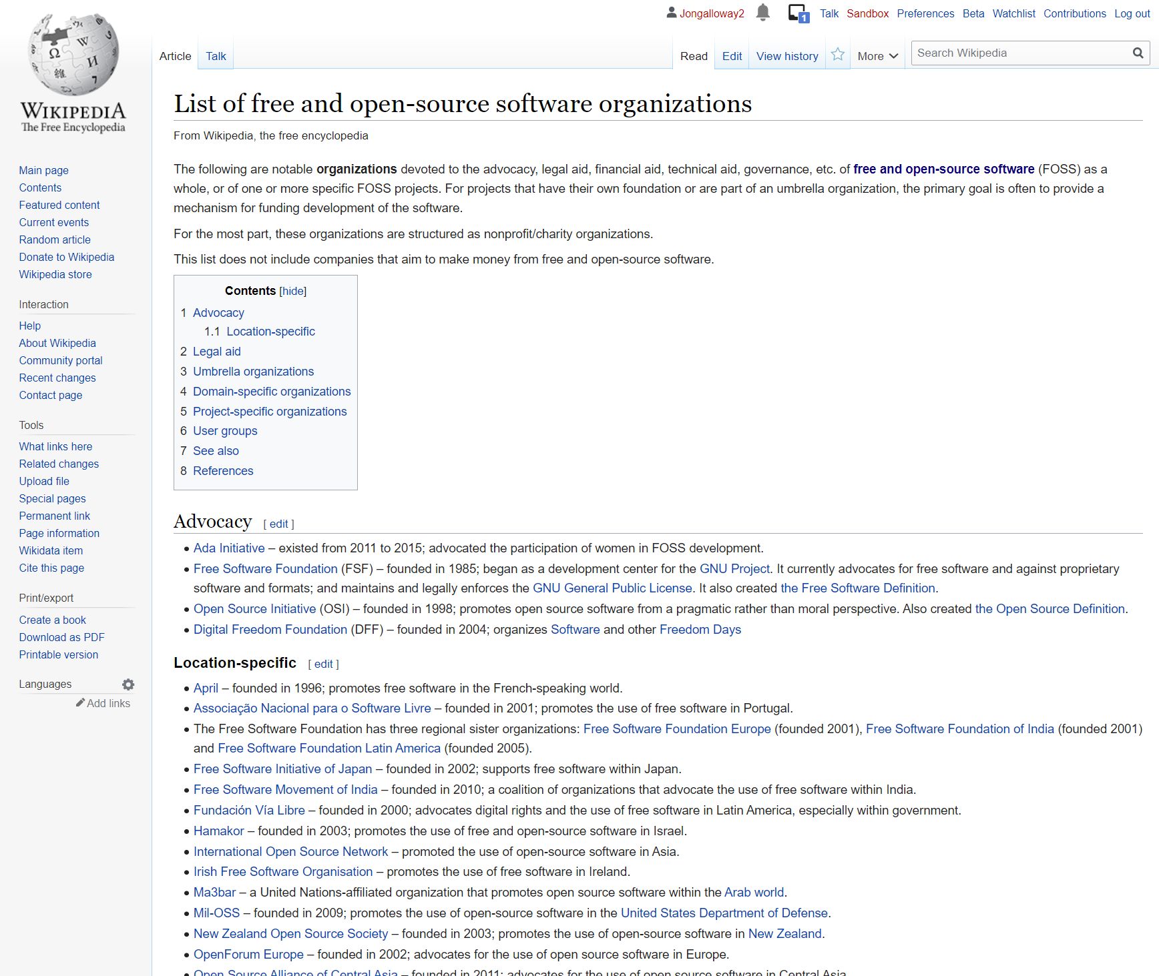
Some other Open Source Software Foundations

Slide 47
Next Steps
Learn more
Join a Foundation
Submit your project for membership

Slide 48
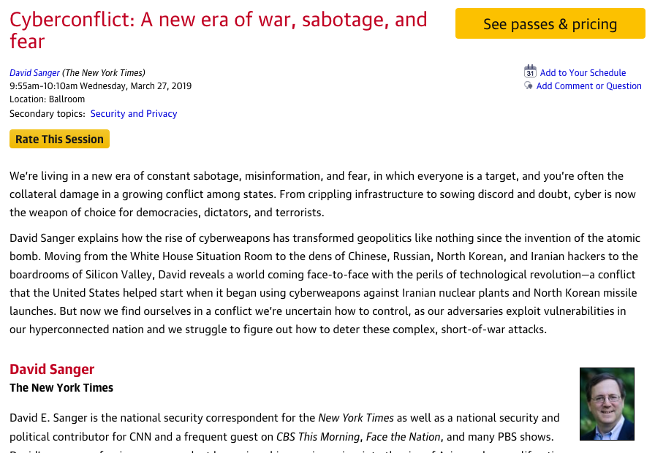
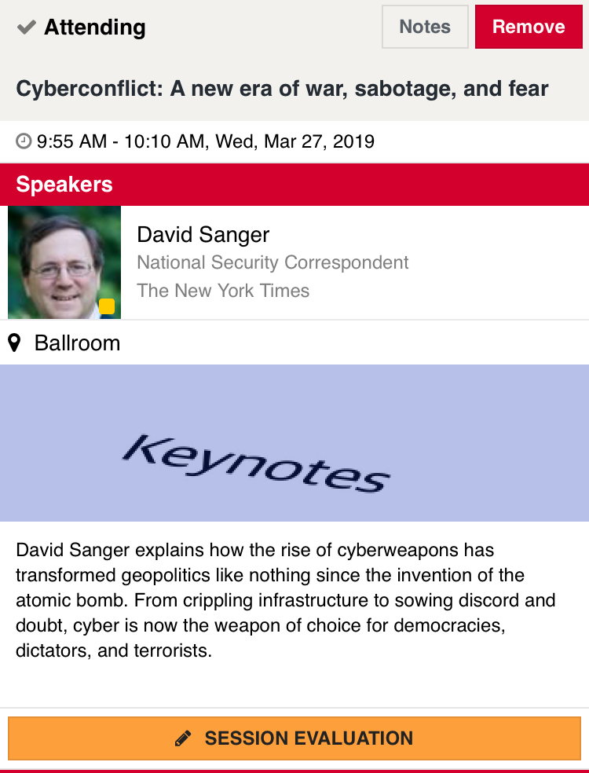
Rate today ’s session
Session page on conference website
O’Reilly Events App

Slide 49

Thanks for your time!
@jongalloway | @dotnetfdn
jon@dotnetfoundation.org

